Slide 1

Welcome

Slide 2
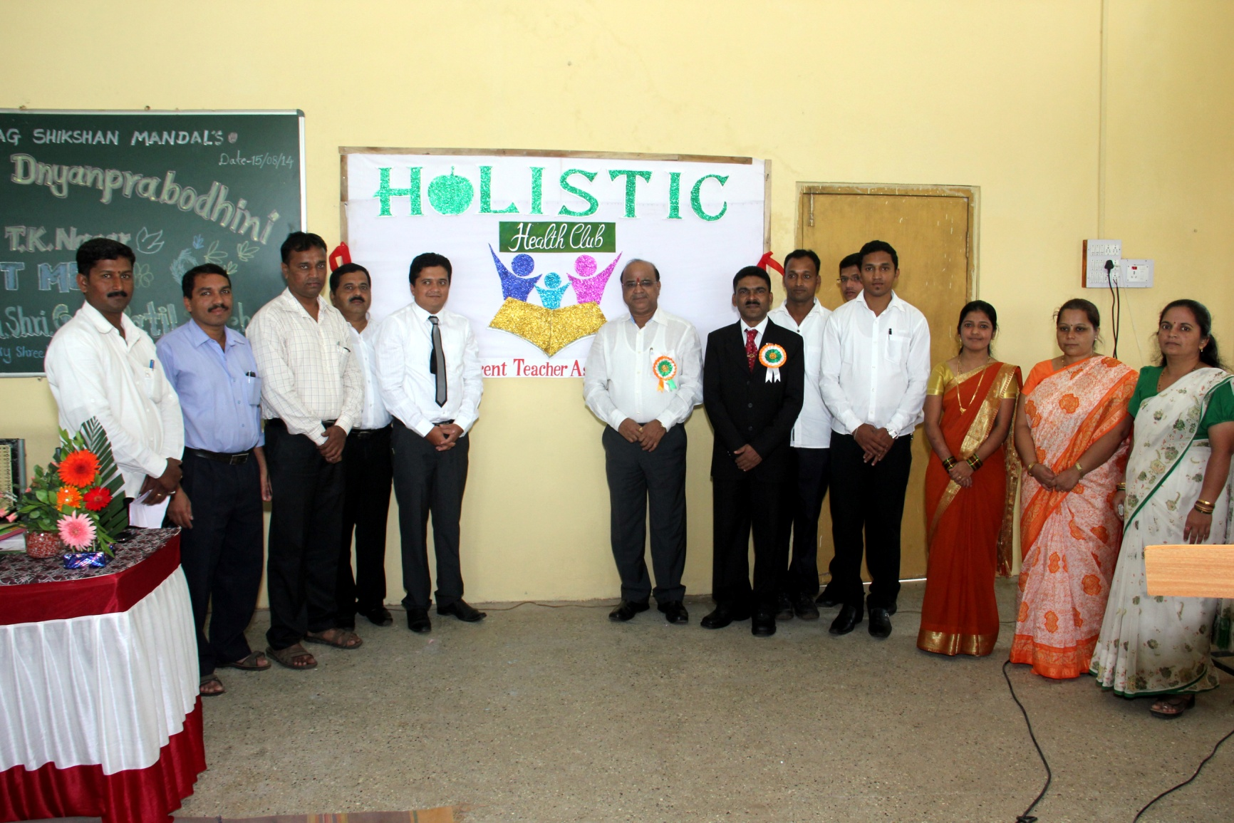
Formation of PTA

Slide 3
Objectives of PTA
PARENTS TEACHERS ASSOCIATION
● To promote the welfare of the children and youth at home, at school and in the society.
● To bring the home and the school into a closer relationship with each other so that parents teachers may co-operate intelligently in the education of a child.

Slide 4
A Parent-Teacher Association at Warana CBSE School organizes a short meeting or conference between the parents and teachers of students to discuss children's progress at school and find solutions to academic or behavioral problems. Parent-Teacher Association supplements the information conveyed by report cards by focusing on students' specific strengths and weaknesses in individual subjects and generalizing the level of inter-curricular skills and competences.
Parent- Teacher Meetings will provide a valuable opportunity for parents to meet and discuss, in person, their son's or daughter's progress at Warana CBSE School with their Tutor and other academic staff. There is also an opportunity to give updates, timely reminders and opinions on academic activities.
A reminder of the forthcoming meeting relevant for your son or daughter is given in the End of Term mailings to parents and guardians. A reply form will be enclosed for you to indicate your intention to attend, which greatly helps our planning.
The pattern of parents' meetings during the academic year will be conveyed time to time to parents.
Please remember that you do not have to wait for a Parents' Meeting if you wish to discuss any aspect of your son's or daughter's progress at Warana CBSE School. Their Tutor will be pleased to talk to you.

Slide 5


“INTERACTION”

Slide 6


Slide 7


Slide 8
“INTERACTION”
I - Interest
N - Nurture
S - Spirit
P - Potential
I - Integrity
R - Respect
E - Education

Slide 9

Thank You

